Slide 1
Sql Transactions
Continuous staff improvement project
Yurii Hohan

Slide 2
Introduction
What is transaction?
Transaction Modes
basics of locking.
Transaction isolation levels.

Slide 3
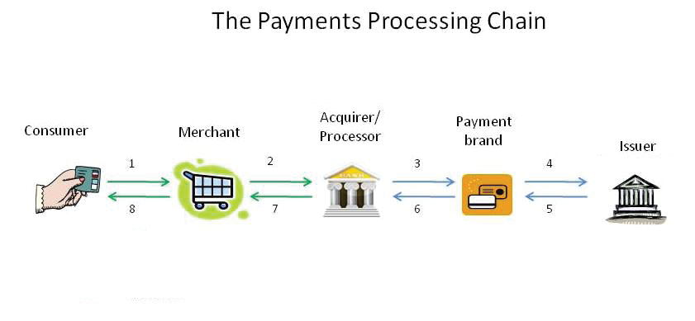
Transactions
A transaction is a logical unit of work. Either both steps succeed together, or both steps must fail together.
Either all the work completes as a whole unit, or none of it does.
Transactions are common in our daily lives.

Slide 4
Transactions. Context
For SQL Server, all changes to database data take place in the context of a transaction.
All data manipulation language (DML) statements such as INSERT, UPDATE, and DELETE.
All data definition language (DDL) statements such as CREATE TABLE and CREATE INDEX.
Technically, even single SELECT statements are a type of transaction in SQL Server; these are called read-only transactions.
As Databases, transaction MUST follow ACID.

Slide 5
Transactions Commands.
Every transaction consists of a T-SQL BEGIN TRANSACTION statement, which marks the start of the transaction in your code. The actual command can also be written as BEGIN TRAN. A name can be assigned to the transaction.
To commit a transaction, issue the COMMIT TRANSACTION command, which you can also write as COMMIT TRAN, COMMIT WORK, or just COMMIT.
To roll back a transaction, issue the ROLLBACK TRANSACTION command, or alternatively, ROLLBACK TRAN, ROLLBACK WORK, or just ROLLBACK.

Slide 6
@@TRANCOUNT and XACT_STATE()
@@TRANCOUNT can be queried to find the level of transaction.
A level of 0 indicates that at this point, the code is not within a transaction.
A level > 0 indicates that there is an active transaction, and a number > 1 indicates the nesting level of nested transactions.
XACT_STATE() can be queried to find the state of the transaction.
A state of 0 indicates that there is no active transaction.
A state of 1 indicates that there is an uncommitted transaction, and it can be committed, but the nesting level is not reported.
A state of -1 indicates that there is an uncommitted transaction, but it cannot be committed due to a prior fatal error.

Slide 7
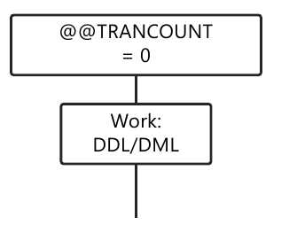
Transactions Modes. Autocommit.
The autocommit mode is the default transaction management mode.
In the autocommit mode, you do not issue any surrounding transactional commands such as BEGIN TRAN, ROLLBACK TRAN, or COMMIT TRAN.
Whatever changes you make to the database are automatically handled, statement by statement, as transactions

Slide 8
IMpLICIT TRaNSaCTION MODE.
In the implicit transaction mode, when you issue one or more DML or DDL statements, or a SELECT statement, SQL Server starts a transaction, increments @@TRANCOUNT, but does not automatically commit or roll back the statement.
You must issue a COMMIT or ROLLBACK interactively to finish the transaction, even if all you issued was a SELECT statement.
SET IMPLICIT_TRANSACTIONS ON;

Slide 9
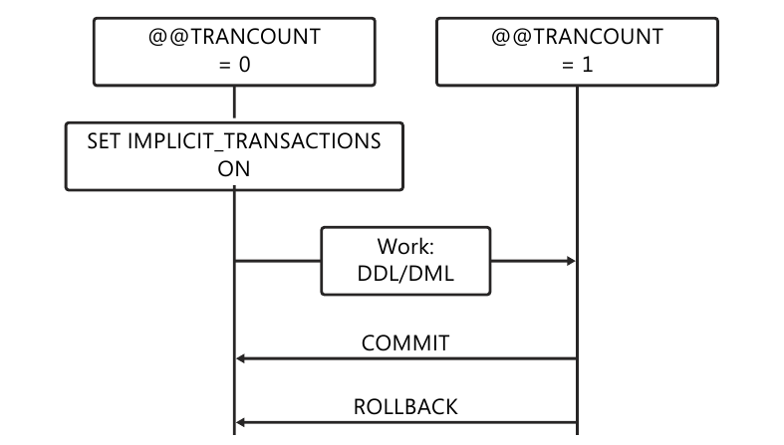
IMpLICIT TRaNSaCTION MODE.

Slide 10
Explicit TRaNSaCTION MODE.
An explicit transaction occurs when you explicitly issue the BEGIN TRANSACTION or BEGIN TRAN command to start a transaction.
In an explicit transaction, as soon as you issue the BEGIN TRAN command, the value of @@TRANCOUNT is incremented by 1. Then you issue your DML or DDL commands, and when ready, issue COMMIT or ROLLBACK.

Slide 11
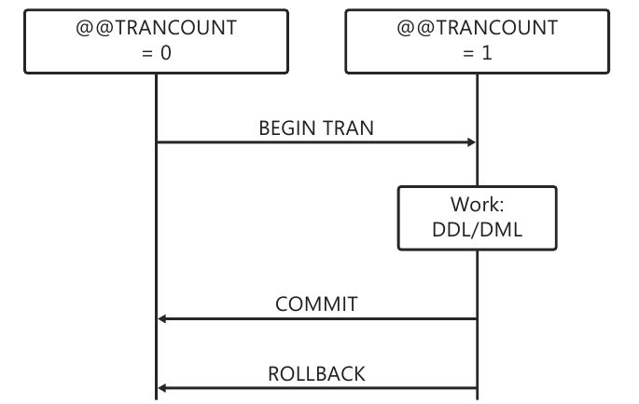
Explicit TRaNSaCTION MODE.

Slide 12
What is the result?
CREATE TABLE t1 (A INT NOT NULL PRIMARY KEY);
CREATE TABLE t2 (B INT NOT NULL REFERENCES t1(A));
INSERT INTO t1 (A) VALUES (1);
INSERT INTO t1 (A) VALUES (2);
BEGIN TRANSACTION;
INSERT INTO t2 VALUES (1);
INSERT INTO t2 VALUES (3); -- Foreign key error.
INSERT INTO t2 VALUES (2);
COMMIT TRANSACTION;
SELECT * FROM t2;

Slide 13
XACT_ABORT
Result for the previous slide:
B
1
2
In order to rollback the entire transaction we need to SET XACT_ABORT is ON
When SET XACT_ABORT is OFF, in some cases only the Transact-SQL statement that raised the error is rolled back and the transaction continues processing. Depending upon the severity of the error, the entire transaction may be rolled back even when SET XACT_ABORT is OFF.
XACT_ABORT must be set ON for data modification statements in an implicit or explicit transaction against most OLE DB providers, including SQL Server. The only case where this option is not required is if the provider supports nested transactions.
OFF is the default setting in a T-SQL statement, while ON is the default setting in a trigger.

Slide 14
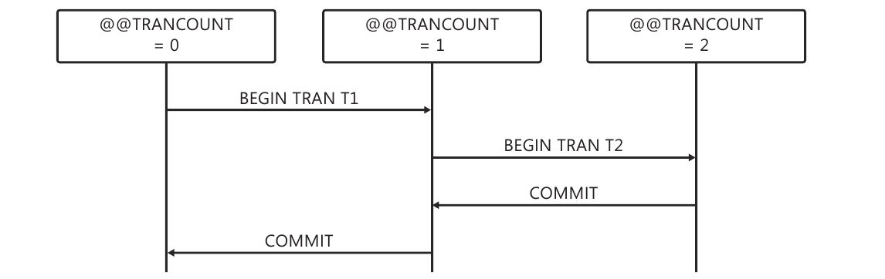
Nested transactions.

Slide 15
Locks and Concurrency
Concurrency – two or more users each trying to interact with the same object at the same time.
Concurrency can be critical to the performance of your system
The foundation of dealing with concurrency is the process of locking
Locks are a mechanism for preventing a process from performing an action on an object that conflicts with something already being done on that object.

Slide 16
Locks
Can have many simultaneous reads on an object.
Typically only one write on an object at the same time.
Process can request “read only access” or “write” access.

Slide 17
Basic Locking
To preserve the isolation of transactions, SQL Server implements a set of locking protocols. At the basic level, there are two general modes of locking:
shared locks. Used for sessions that read data—that is, for readers
exclusive locks. Used for changes to data—that is, writers

Slide 18
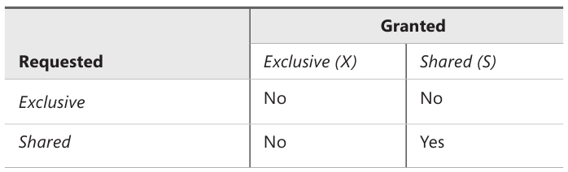
Basic Locking

Slide 19
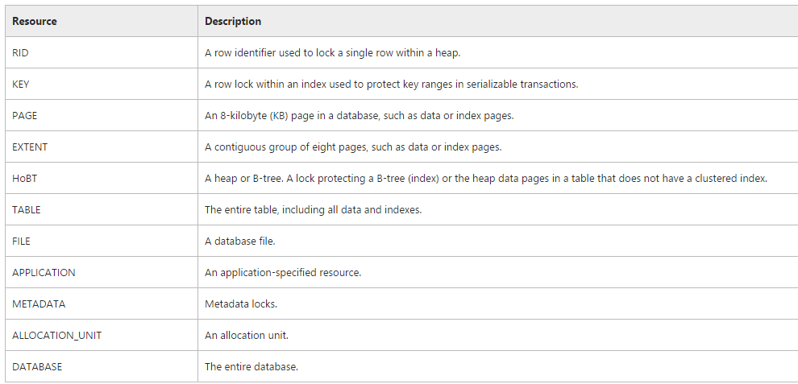
Lock Granularity

Slide 20
Find Locks
select
object_name(p.object_id) as TableName,
resource_type, resource_description
from
sys.dm_tran_locks l
join sys.partitions p on l.resource_associated_entity_id = p.hobt_id

Slide 21
Locking. Concequences
Blocking. If two sessions request an exclusive lock on the same resource, and one is granted the request, then the other session must wait until the first releases its exclusive lock.
Deadlocking. A deadlock results from mutual blocking between two or more sessions when they need more than one lock to be granted. Both processes need lock A and B. First has lock A, second has lock B and they cannot proceed. After some time DB will choose deadlock victim and transaction will be roll backed.

Slide 22
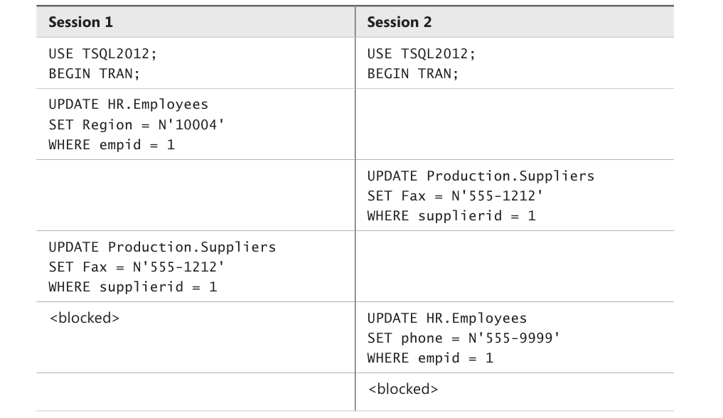
Deadlock Example.

Slide 23
Transaction Isolation Layers
During the time a transaction is changing some data, SQL Server never allows that data to be changed by any other transaction until the first transaction finishes, nor can your transaction change any data that other transactions are changing until they finish.
Therefore, some blocking and deadlocking is always possible when transactions change data. Writers always block writers, and exclusive locks in one transaction are never compatible with exclusive locks in another.
But blocking and deadlocking can be increased or reduced based on varying the degree of isolation of the transaction ACID properties.

Slide 24
Transaction Isolation Layers
Read Uncommited.
Read Commited.
Repeatable Read.
Serializable.
Read Committed Snapshot Isolation
Snapshot Isolation

Slide 25
Setting transaction Isolation Level
SET TRANSACTION ISOLATION LEVEL READ COMMITTED;
BEGIN TRANSACTION;
SELECT FirstName FROM EmployeeInfo
WHERE EmpID = 1;
--some heavy insert logic
SELECT FirstName FROM EmployeeInfo
WHERE EmpID = 1;
COMMIT TRANSACTION;

Slide 26
Read Uncommited
This isolation level allows readers to read uncommitted data.
This setting removes the shared locks taken by SELECT statements so that readers no longer are blocked by writers. However, the results of a SELECT statement could read uncommitted data that was changed during a transaction and then later was rolled back to its initial state. This is called reading dirty data or dirty read.

Slide 27
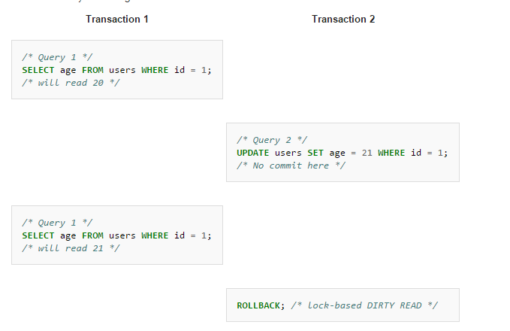
Dirty read

Slide 28
Read commited
This is the default isolation level.
All readers in that session will only read data changes that have been committed.
So all the SELECT statements will attempt to acquire shared locks, and any underlying data resources that are being changed by a different session, and therefore have exclusive locks, will block the READ COMMITTED session.

Slide 29
Non-Repeatable Reads
A non-repeatable read occurs when you read the same record twice in a transaction, and a separate transaction alters that data in the interim.
To prevent it set our isolation level to be “repeatable read” or “serializable”
This could cause as many problems as it fixes – but still an option
One can make a soft alternative solution for such problems.

Slide 30
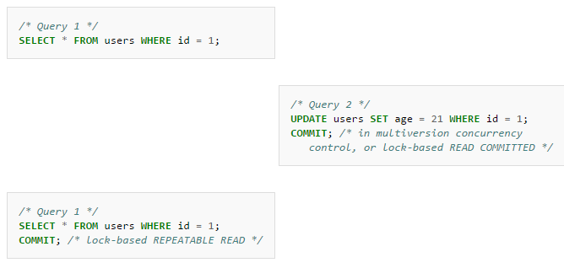
Non-Repeatable Read

Slide 31
Repeatable Reads
Repeatable read. This isolation level, also set per session, guarantees that whatever data is read in a transaction can be re-read later in the transaction. Updates and deletes of rows already selected are prevented. As a result, shared locks are kept until the end of a transaction.
However, the transaction may see new rows added after its first read; this is called a phantom read.

Slide 32
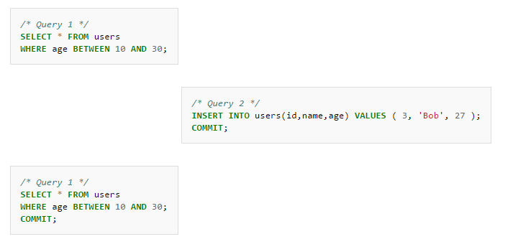
Phantom Read

Slide 33
Serializable
This isolation level is the strongest level and is set per session. At this level, all reads are repeatable and new rows are not allowed in the underlying tables that would satisfy the conditions of the SELECT statements in the transaction.
Extremely strict, practically makes all work with the database serial, should be avoided.
Prevents all forms of concurrency issues except for a lost update.

Slide 34
Lost Updates
Update is successfully written to database but then is overwritten by another transaction.
Two transactions read a record
First makes change
Second make change, losing first update
Can be solved in the C# program code by introducing versioning

Slide 35
General recommendations
In order to minimize blockings and deadlocks:
Use short transactions
Use same sequence of accessing tables inside transactions
Read as few records and modify as few records as possible
Choosing isolation levels:
Consider always sticking to default READ COMMITTED
When there is a really good reason, consider using more isolated level
When we collect statistical data, consider using READ UNCOMMITTED

Slide 36
Transaction Isolation & Versioning
MS SQL Server can also use row versioning
Isolation accomplished by combination of locking and versioning
Write locks block other writers
Write locks do not block readers
Readers do not lock by default
Readers do not block writers by default
Known as snapshot isolation
Old rows are copied into tempdb for reading
Database setting

Slide 37
Moving to Read Commited Snapshot
USE master
GO
ALTER DATABASE Demo SET READ_COMMITTED_SNAPSHOT ON
GO
...
SET TRANSACTION ISOLATION LEVEL READ COMMITTED
BEGIN TRAN

Slide 38
Assignment
Try Out transactions in three modes.
Block another transaction and view the locks.
Reproduce dirty read, non-repeatable read and Phantom read.
Be prepared for a test.

